Slide 1
ADDRESS BY MRS LINDIWE SANGWENI-SIDDO: MEMBER OF THE TOURISM B-BBEE CHARTER COUNCIL LOCAL GOVERNMENT TOURISM CONFERENCE EMPERORS PALACE, KEMPTON PARK, GAUTENG PROVINCE: 30 MARCH 2015

Slide 2
BACKGROUND
Tourism became the first to have its Sector B-BBEE Codes published ahead of other industries in May 2009 – as a Section 9 (1) Code, in terms of the B-BBEE Act No. 53 of 2003 by the the dti Minister;
Tourism Codes were given the same legal status as the the dti’s Generic B-BBEE Codes of Good Practice.

Slide 3
OBJECTIVES OF THE CODES
The codes were meant to tackle the two main challenges in the tourism sector:
the need to become more globally competitive;
the need to include Black people in the Tourism Sector.
Tourism B-BBEE Codes expressed the commitment of all stakeholders in the Tourism Sector to the transformation of the sector and its commitment to working collectively to ensure that the opportunities and benefits of the tourism sector are extended to Black South Africans as well.

Slide 4
THE ROLE OF TOURISM
Minister Hanekom said: “the tourism sector represents more than 9% of our country’s gross domestic product and an estimated 1.4 million job opportunities. Tourism touches the lives of so many individuals, families, communities and small enterprises on a daily basis. It is already a force for good”.
Judging by the role that tourism as a new industry continues to play in our economy down to the level of our community, it is indeed a good tool we can all use to advance radical transformation in this country.
Tourism is a “new gold”, which is not only confined to the borders of Gauteng Province.
Tourism is a “gem” which does not discriminate. It is found in every province, and even within the poorest communities lie the richest tourism experience.

Slide 5
B-BBEE MONITORING BODY
To measure transformation, the Codes were developed with clear Scorecard weightings and targets since 2009;
On 27 August 2012, the Minister of Tourism appointed members of the Tourism B-BBEE Charter Council to monitor transformation in the sector.
The role of the Council is to:
Provide guidance on sector specific matters effecting B-BBEE in entities within the sector;
Compile reports on the status of broad-based black economic empowerment within the sector; and
Share information with sector members, approved accreditation agencies, B-BBEE Commission, B-BBEE Presidential Advisory Council, Line Minister and the Minister of Trade and Industry.

Slide 6
ARE WE ACHIEVING TRANSFORMATION IN THE TOURISM SECTOR?
The findings of the State of Sector Transformation Report revealed that:
Large enterprises have generally had better transformation outcomes than small enterprises;
Not much achievement has been recorded in the area of ownership;
In particular, the vast majority of enterprises have no black female share-holding;
The prevalence of family owned enterprises and funding constraints further complicate the issue;
Buying from black owned suppliers is still at low levels;

Slide 7
ARE WE ACHIEVING TRANSFORMATION IN THE TOURISM SECTOR?
Black women are not benefitting as expected from the management control element, with the argument being that capacity constraints on the part of this group is the main impediment;
The use of Generic Codes as opposed to the Tourism Scorecard remains prevalent – the “non-optionality” clause in the Revised Generic Codes and B-BBEE Amendment Act 2013 should help reduce this problem;
Levels of awareness of the B-BBEE legislation and Tourism B-BBEE Codes in particular and its purpose and benefits are fairly low across the tourism industry;
On the contrary, there has been relatively good performance on spending on socio-economic development.

Slide 8
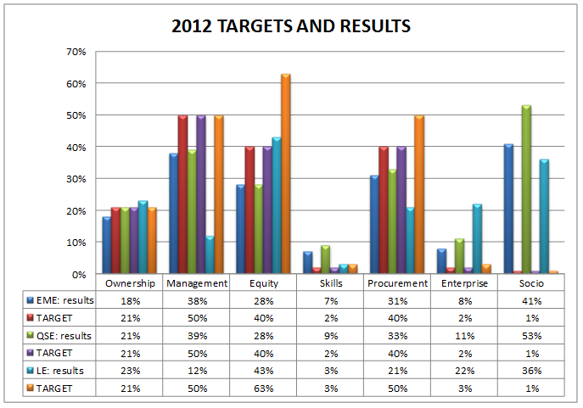
STATE OF TRANSFORMATION IN TOURISM

Slide 9
ARE WE ACHIEVING TRANSFORMATION IN THE TOURISM SECTOR?
Western Cape has the largest number of tourism enterprises, followed by Gauteng and KZN;
These three provinces account for more than three quarters (77%) of the total number of tourism enterprises;
Achievement of the targets for black shareholding was highest in the ‘Travel Distribution Systems’ sub-sector in KZN (28%), followed by Limpopo (25%) and Gauteng (23%);
Whilst the Western Cape boasts the highest number of tourism enterprises, only one-in-ten had achieved the black shareholding target.

Slide 10
DISTRIBUTION OF TOURISM ENTERPRISES

Slide 11
TRANSFORMATION TRENDS IN OTHER SECTORS
Apart from tourism, studies by the dti highlighted that transformation is still a challenge across all sectors.

Slide 12
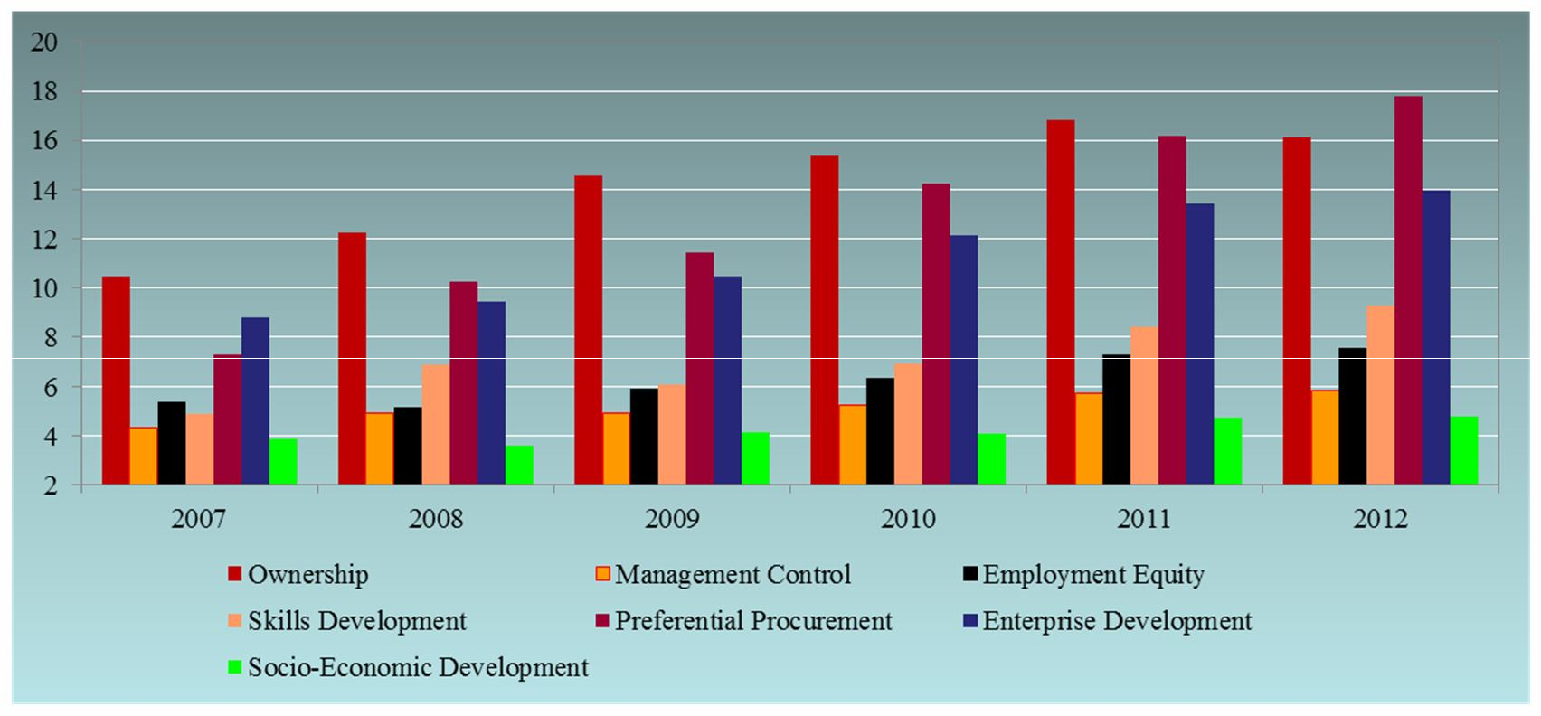
STATE OF TRANSFORMATION IN ALL SECTORS
Data Source: Empowerdex

Slide 13
WHAT WAS DONE TO IMPROVE THE SITUATION?
To tighten the transformation process in general, the dti gazetted the Amended B-BBEE Generic Codes on 11 October 2013 and mandated all Sector Charter Councils to overall their sector specific codes to align to the dti’s codes as well;
In June 2014, the Tourism B-BBEE Charter Council developed an initial draft Tourism B-BBEE Codes;
After approval by the Minister of Tourism, the Council embarked on nation-wide stakeholder consultations from July to November 2014 to solicit inputs and comments from all interested and affected persons and organisations, including focussed group sessions with the key national bodies;
An extension for submission of written comments and additional consultations was given to all stakeholders until December 2014;
The Council received an overwhelming support from many tourism stakeholders in all the nine provinces on the amendments, and adopted the Codes on 25 March 2015;
The Codes will be submitted to the Tourism Minister for consideration and concurrence before submitting to the dti for publishing in the government gazette.

Slide 14
WHAT MORE IS THE COUNCIL DOING?
Amongst other things:
Council developed a B-BBEE Award Category for the Lilizela Tourism Awards to celebrate the best performers on transformation in the tourism sector;
Developed a guide on procurement needs of large enterprises in the tourism sector, which will once finalised channel small businesses to the right niches in the sector where they can find better procurement opportunities and equip themselves with information to meet the demands ahead;
The Council will also develop a database of black owned enterprises to support Enterprise and Supplier Development initiatives to accelerate the empowerment of SMMEs and new entrants in the tourism sector;
The Executive Development Programme to capacitate Black women in tourism will be developed in conjunction with a distinguished South African business school. The ultimate goal is to capacitate black female managers to graduate them into black industrialists for the tourism sector in the near future.

Slide 15
CONCLUSION
Your contribution to the empowerment of our people in the sector is highly appreciated.
The Amended Tourism B-BBEE Codes will usher a new era on transformation in the tourism sector;
Let us all embrace the Codes so that we can move a step closer towards achieving transformation in our beautiful sector of tourism by, amongst other means, increasing the number of tourism entities reaching the targets set by the new Codes.

